Slide 1
PROJECT TITLE
CAPSTONE PROJECT
Presented By: Chanchal Soni
Student Name : Chanchal Soni
College Name & Department : Mandsaur University Mandsaur, Madhya Pradesh, India; Computer Science and Application

Slide 2
OUTLINE
Problem Statement
Technology used
Wow factor
End users
Result
Conclusion
Git-hub Link
Future scope

Slide 3
Problem Statement
In the modern digital era, ensuring secure communication presents a significant challenge. While encryption safeguards data by making it unreadable, it also signals the presence of confidential exchanges. This project addresses the need for discreet message transmission through steganography—a technique that conceals information within seemingly ordinary images. The proposed solution is an intuitive GUI application that seamlessly embeds text messages into digital images, enabling covert communication without drawing attention.

Slide 4
Technology used
Libraries & Platforms
Libraries:
OpenCV (cv2)
Tkinter & ttk
NumPy
Pillow
os
Pathlib
Platform:
Visual Studio Code

Slide 5
Wow factors
Modern Dark-Themed GUI - Professional interface with real-time status updates and color-coordinated design, making steganography accessible to non-technical users.
Dual Input System - Supports both direct text input and file loading, with automatic message length validation and image capacity checking.
Enhanced Security - Password protection for encoding/decoding with robust error handling, while maintaining original image quality.
Smart Message Processing - Efficient pixel utilization and automatic message length preservation, preventing data overflow while ensuring message integrity. These features combine security with user-friendliness, setting it apart from typical steganography tools that sacrifice one for the other.

Slide 6
End users
Privacy-Conscious Individuals
Educational Sector
Security Professionals
Digital Rights Activists

Slide 7
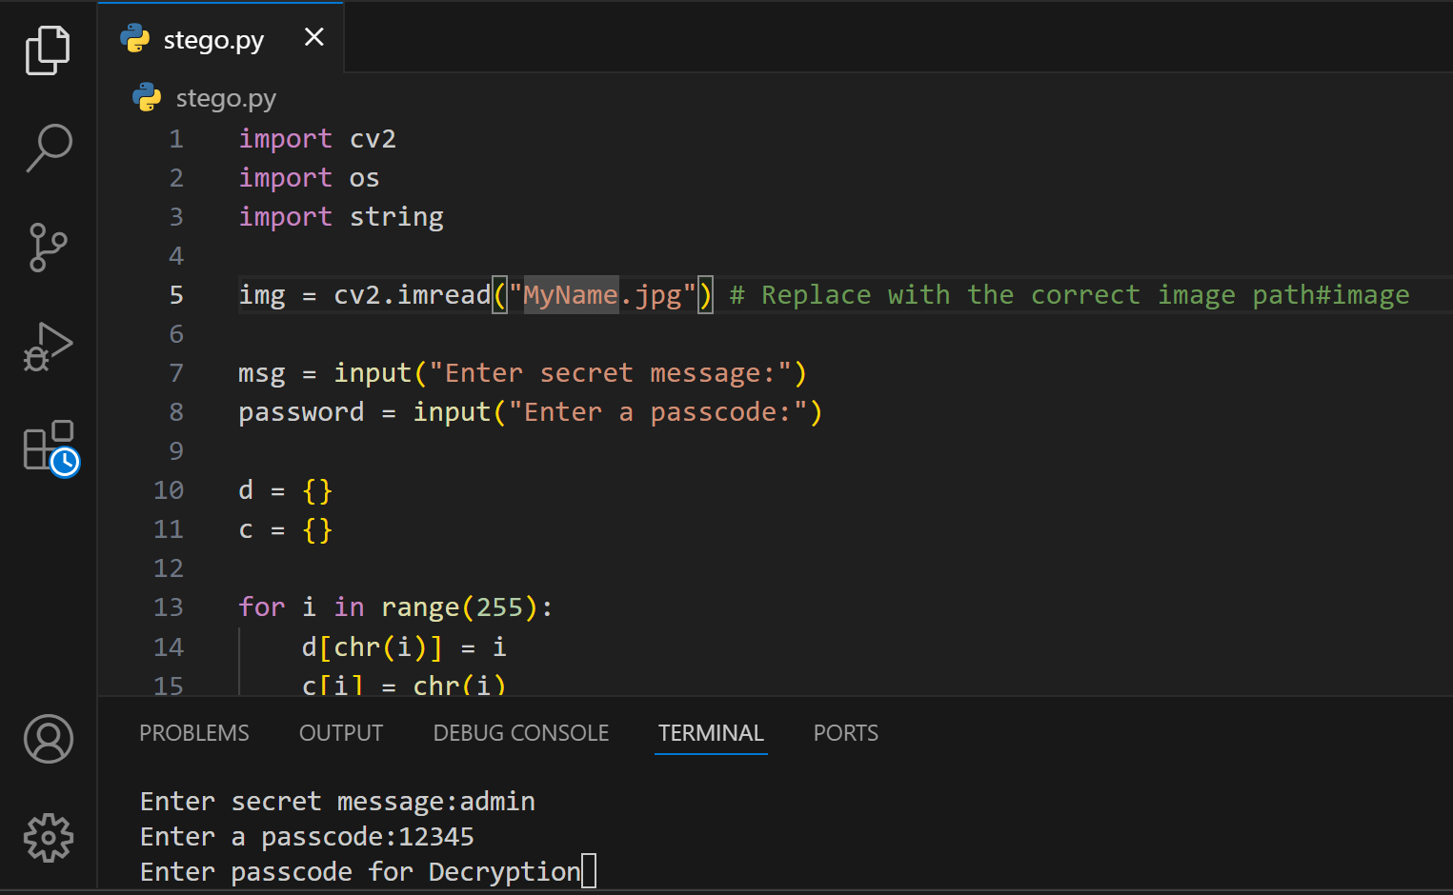
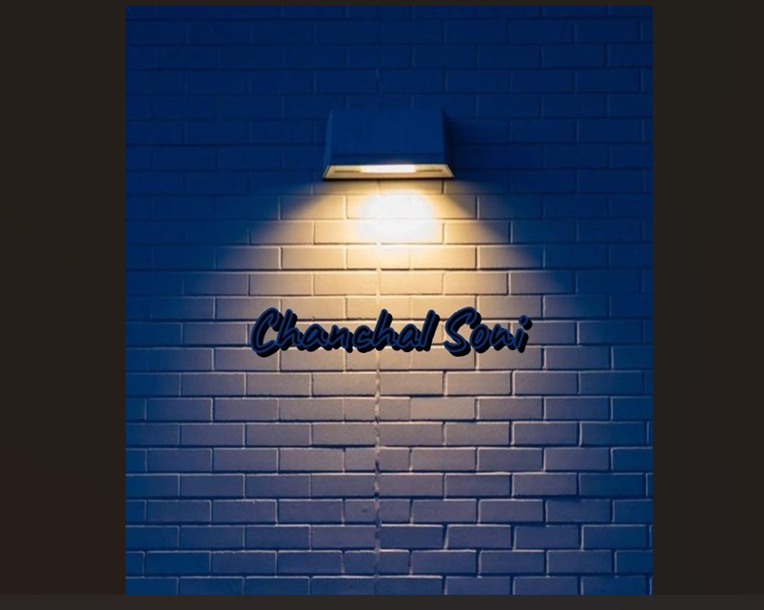
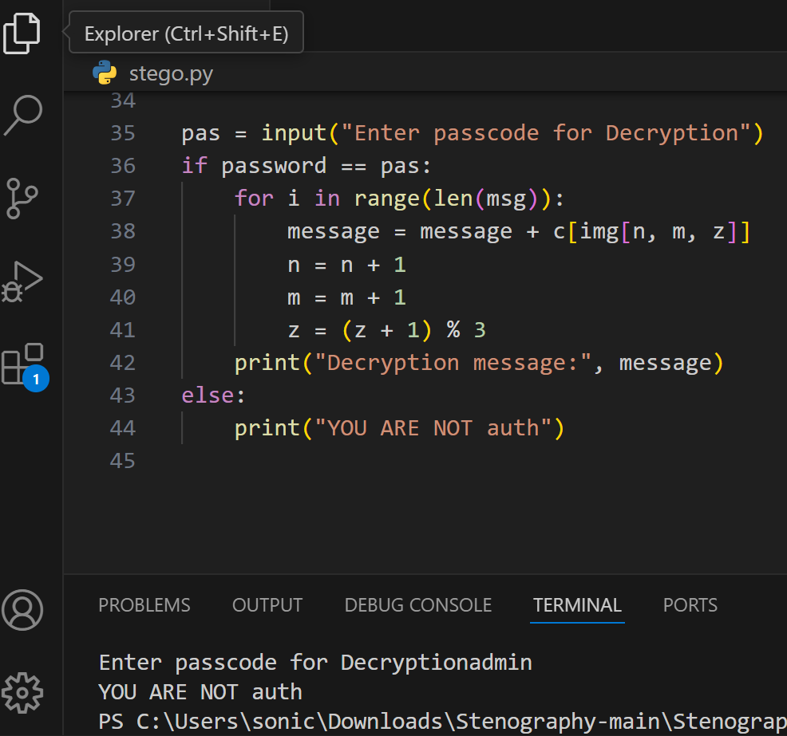
Results

Slide 8
Conclusion
This Image Steganography application successfully addresses the need for covert communication by providing a secure, user-friendly solution for hiding messages within digital images. The project achieves its core objectives by:
Security & Privacy: Successfully implementing LSB steganography with password protection, making secret messages undetectable to casual observers.
Accessibility: Creating an intuitive dark-themed GUI that makes steganography accessible to both technical and non-technical users.
Reliability: Ensuring message integrity through automatic capacity checking and efficient pixel utilization, preventing data loss or corruption.
The project effectively bridges the gap between security and usability, making secure communication available to privacy-conscious individuals, educators, and security professionals

Slide 9
GitHub Link
https://github.com/sonichanchal702/CyberAICTE_Prj.git

Slide 10
Future scope(optional)
Enhanced Security : Implementation of advanced encryption algorithms (AES/RSA) alongside steganography, and support for hiding messages in audio/video files.
Advanced Features : Integration of blockchain for message verification, cloud storage support for secure image sharing, and AI-powered steganography detection resistance.
Cross-Platform Development : Mobile application development (Android/iOS) and web-based version with real-time collaboration features.

Slide 11
THANK YOU

